Slide 1
Getting your ~$30: Maximizing the Potential of Your Volunteers

Slide 2
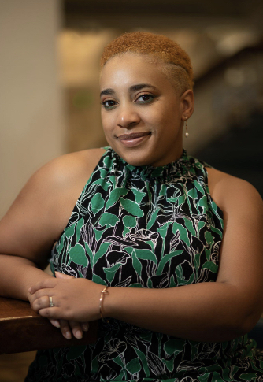
Who is Adrienne Taylor, CFRE?
Chapter: Greater Cincinnati (Current President)
Day Job: Senior Consultant with Skystone Partners
Experience Areas: Women/Gender Equity; Higher Education; Performing Arts
Walk-up Song: That Lady by the Isley Brothers
Likes: Gut-busting Laughter; greeting cards
Dislikes: Unclean/unfinished paper towel perforations; book sleeves
Wife, mother of 2 (my broke besties!)

Slide 3
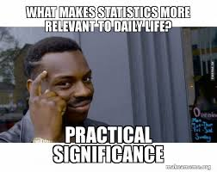
VOLUNTEERS:
STATS & FACTS
Notes:
Let’s take a few minutes to ground ourselves in some data about volunteers. This information should be kept in your back pocket as you devise your volunteer plans & processes.

Slide 4
Volunteerism (välənˈtirizəm)
The act of contributing free labor to conduct community service or support a nonprofit organization.
Notes:
Read slide
It is the principle of donating time and energy towards a greater cause. Volunteers help change the lives of those in their community as a social responsibility rather than receiving a financial reward.

Slide 5
Formal
helping others through organizations.
Informal
helping others outside of an organizational context.
VS

Slide 6
Did You Know?
1736
1ST documented act of Volunteerism – Firehouse
Led to the start of the Salvation Army, American Red Cross and United Way.

Slide 7





1
2
3
4
5

Slide 8

feeling more socially connected
warding off loneliness and depression
lending a greater sense of purpose to life
Mental
Health
Benefits
Notes:
Talk about the LC Reunion
- this event hit all of these points

Slide 9
1
fundraising or selling items to raise money (35.97%)
preparing or distributing food (34.22%)
2
Notes:
Source US Census Bureau
What you see listed is the top two national volunteer activities.

Slide 10


60.7 million adults
National Volunteer Week
3rd week of April
THIS WEEK!!!
4.1 billion hours

Slide 11
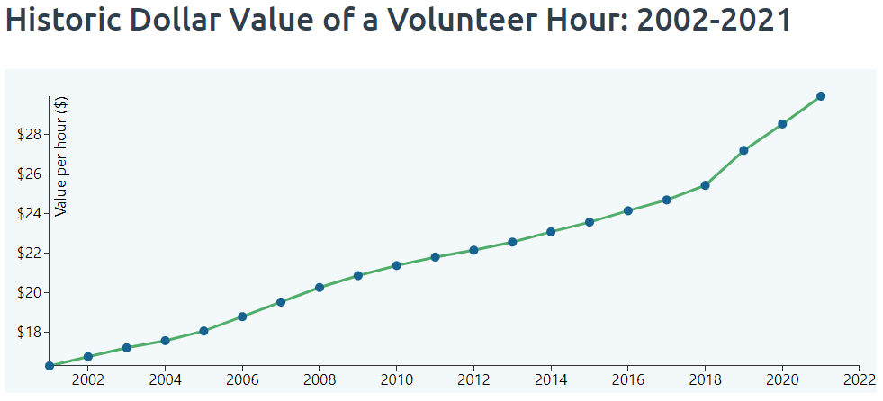
Notes:
Looking at this chart we can see that average value of a volunteer hour over nearly 20 years has increase by $13.
Credit: independentsector.org

Slide 12
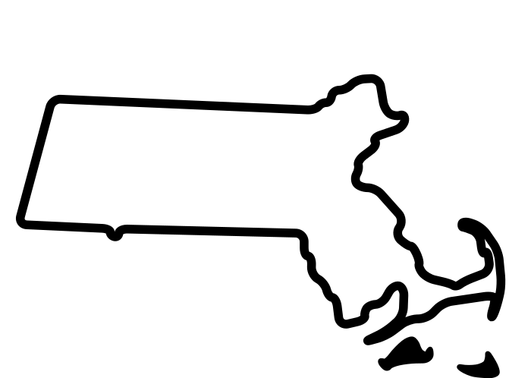
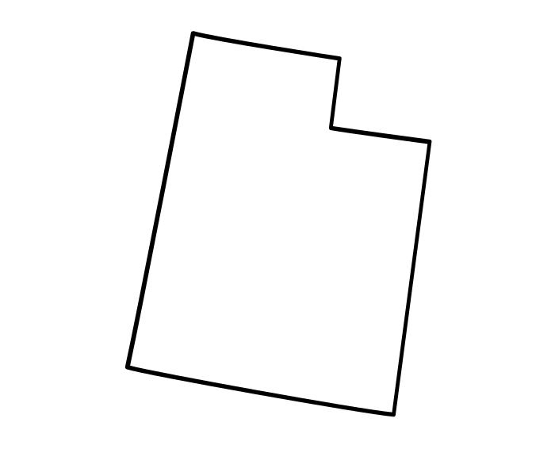




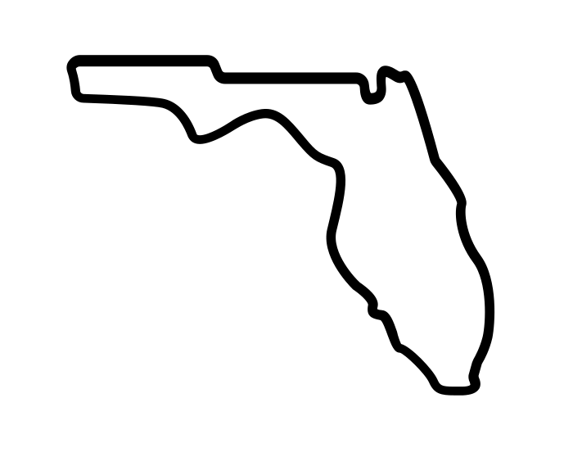
$36.38
51%
33.8%
Gen X
$28.54
26.5%
$22.57
22.8%
Notes:
GenX has the most volunteers @ 36.4%

Slide 13
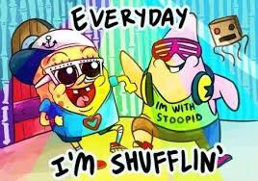
VOLUNTEERS:
MOVES
MANAGEMENT
Notes:
Now that we have those little nuggets in our back pockets, let’s leverage this against the lens of moves management.

Slide 14
Fundraising Cycle
Identification
Cultivation
Ask
Stewardship
Qualification
Notes:
The Fundraising Cycle – here is something that you are bound to see at least once a year.
However, when I think of volunteers…

Slide 15
Volunteer Cycle
Identification/
Evaluation
Ask
Experience
Orientation
Notes:
Identification: Same process as in the fundraising cycle.
Orientation: More than likely at this point they may have deep knowledge of what aspect of your organization. Do an orientation with them (including talking about all of the volunteer experiences)
Ask: what is resonating with you; how do you want to best spend your valuable time with us?
Experience: seamless; tangible benefits (swag); inclusive elements (in person/virtual); say thank you
Evaluation: what worked? Round 2? Anyone you want to bring along?

Slide 16
Traditional
Donor
Pyramid
First-timer Annual Giving
Major Giving
Legacy Giving
Repeat Annual Giving
Special/Major Giving
Notes:
Hopefully, you have all seen some iteration of the donor pyramid.

Slide 17
Volunteer
Pyramid
Expertise-Based Volunteer
Board Member
“Where Do You Need Me?”
Philanthropic Volunteer
Committee Chair
Notes:
Let me introduce you to my volunteer pyramid. It carries the same moves management ideology as the traditional donor pyramid.
Expertise-Based Volunteer – this is the normal entry point for volunteers; The use their strengths to propel your mission
Philanthropic Volunteer – at this point they have made a gift or brought someone else into your space, essentially expanding their philanthropic footprint with your organization. I would also say that they could be participating on multiple committees.
Committee Chair – they are so involved that they would like to shepherd a group of volunteers themselves. They know the ropes; super comfortable with the mission; plays a variety of roles.
Board Member – these people either want to work harder or begin to dream big with you (working board vs advisory board); they understand that they are to be present/supportive of all the pieces of your org.
The people at the top are exactly how it sounds – they have term limited out for board service; served on all the committees; leveraged their networks; given the majority of their volunteer time to your organization.

Slide 18
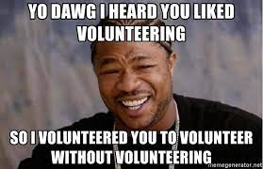
SAMPLE COMMUNICATIONS

Slide 19
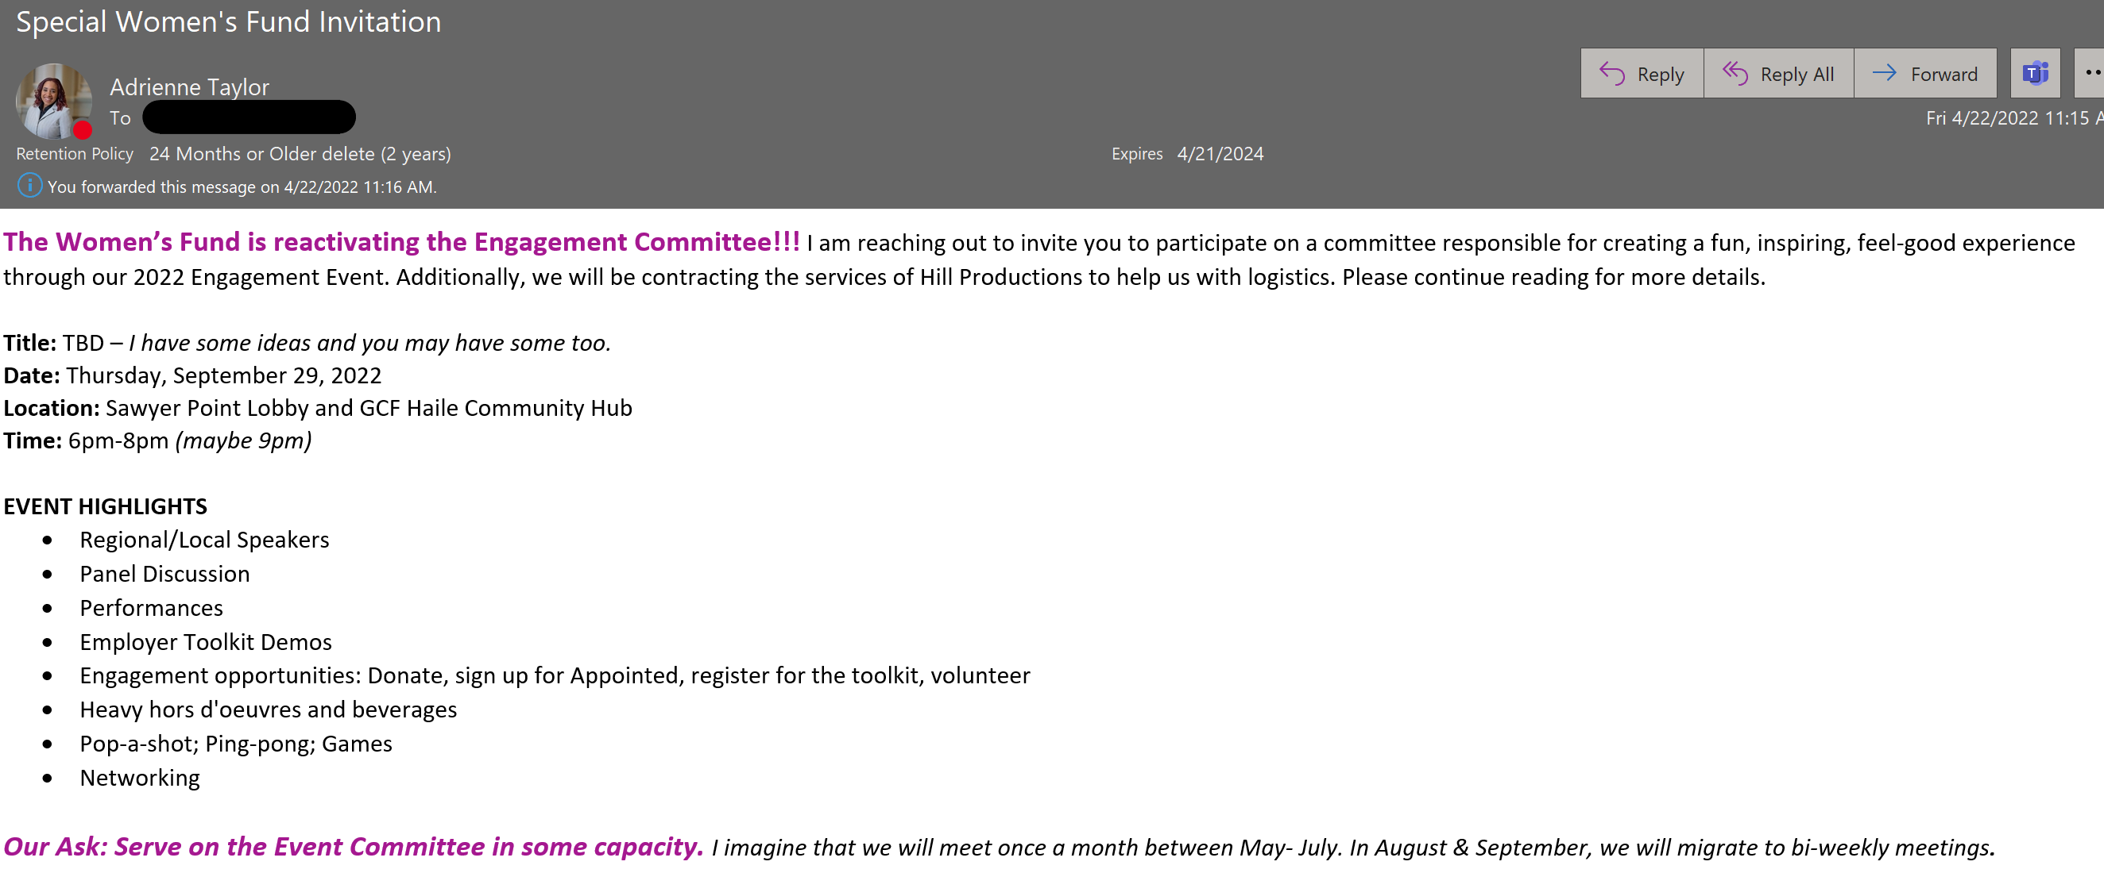
Be excited! Be upfront about the responsibilities Include the time commitment
Notes:
Here’s a sample invite. This is for an event.
Tweak this for the type of work you would like for them to execute.

Slide 20
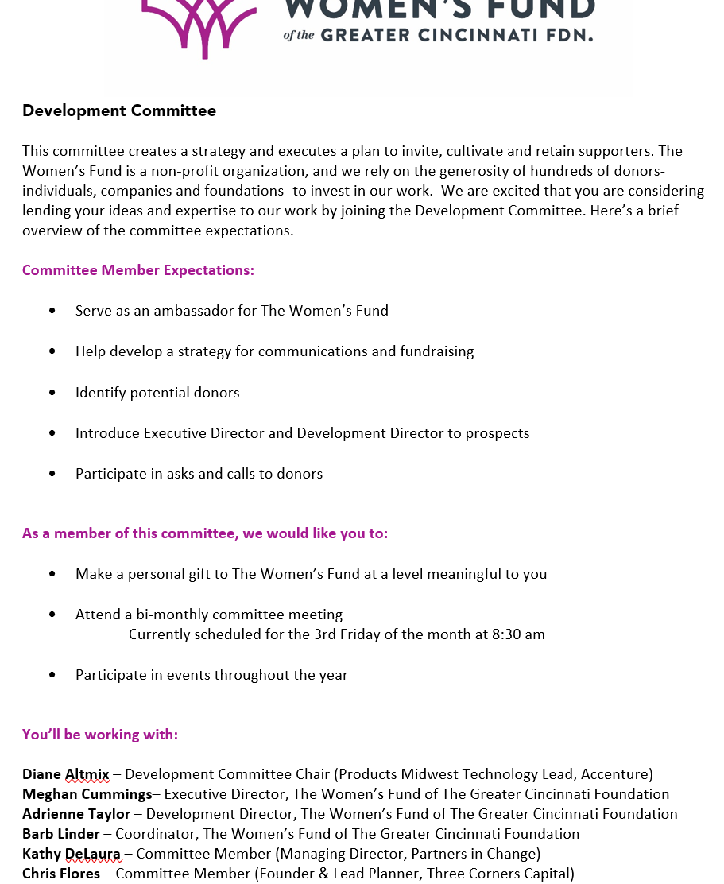
Setting
Expectations
What does the committee do?
What are the key responsibilities?
Who is currently serving?
Notes:
If you get the vibe that something more formal needs to be created. Develop a committee overview document.

Slide 21
Committee
Roles
Notes:
You may need to get detailed with your committee members on the specific tasks you want them to complete and how they fit into the entire picture. Sometimes leaving the specific tasks out can be a deterrent. This allows them to opt in and out, comfortably.

Slide 22
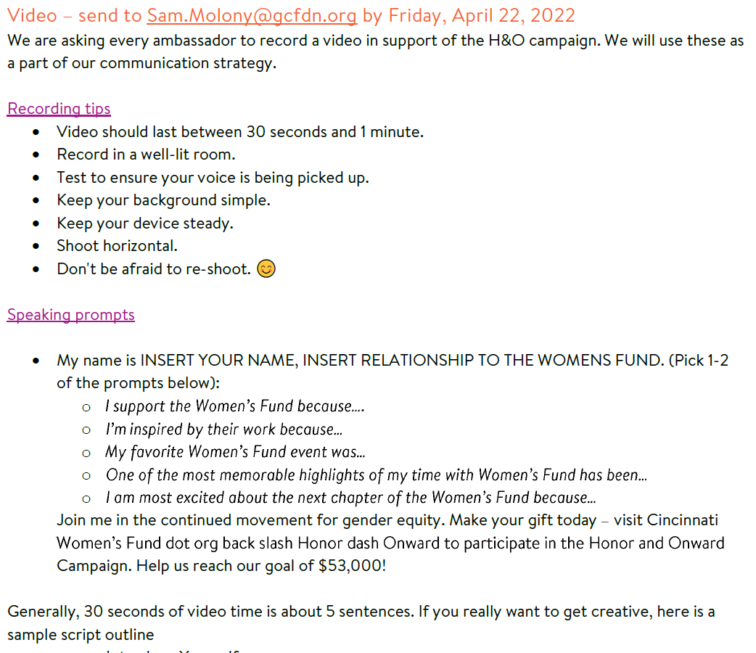
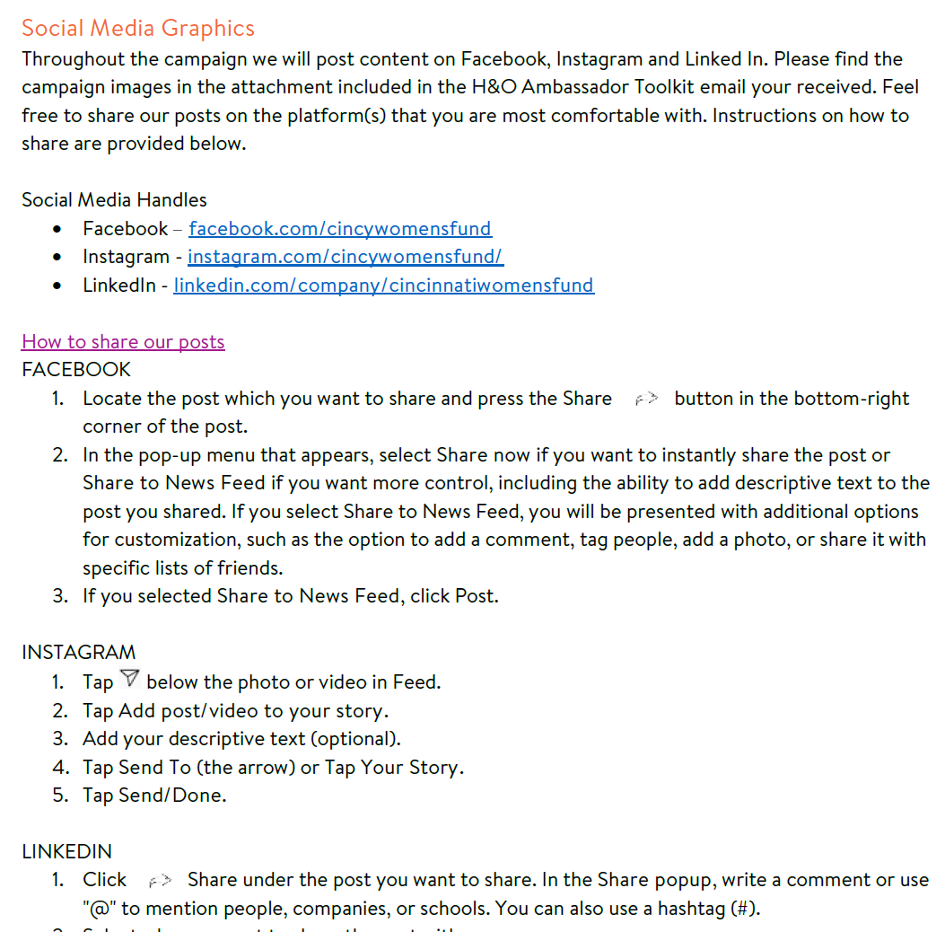
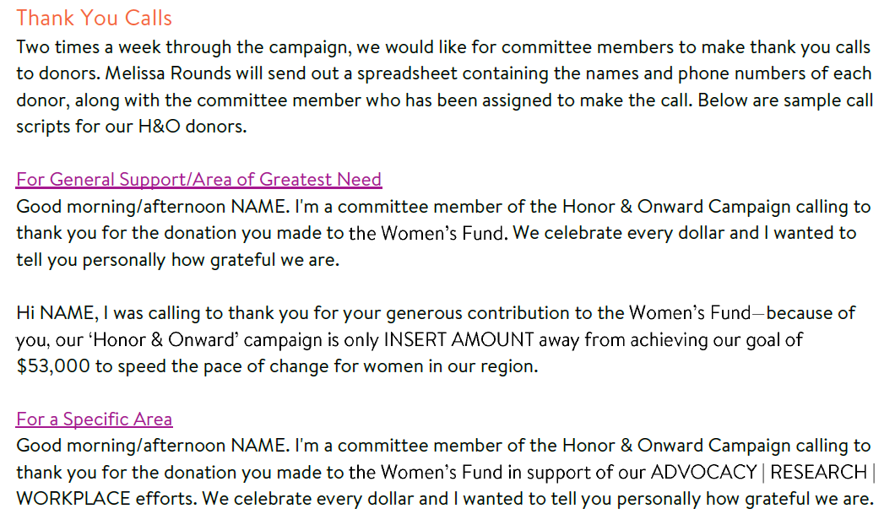
Toolkits
Notes:
Toolkits provide a great way to equip your volunteers with what they need to execute whatever they signed up to do.
Here is a sample of a toolkit that I am currently using. I prepared this in both digital (pdf and word) and printed formats.

Slide 23
Resources
Americorps.gov
VolunteerHub.com
US Census Bureau
IndependentSector.org
TrackItForward.com
VolunteerFDIP.org

Slide 24
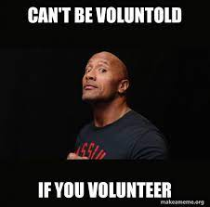
Q & A TIME!
Notes:
Trends
-virtual volunteering
-volunteer management software
-gamification
Final Thoughts
-Show gratitude at the same level you would donors
-This does take time to operationalize, but it is so worth it.

Slide 25
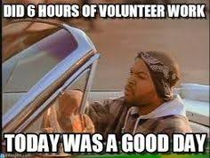
LinkedIn: @AdrienneNTaylor
Email: AdrienneNMcDade@gmail.com

